Slide 1
What is Django?
A high level python web framework
Encourages rapid development and clean , pragmatic design
Perfection and automation
Widely used

Slide 2
Django vs PHP
It can handle complex applications
It can handle multiple requests easily while php is complex
But PHP is easier than Django

Slide 3
Famous websites using Django
Instagram
Mozilla Firefox
NASA
onion

Slide 4
Prerequisites
How to turn on laptop
Python 3
R
How to run ml models thorugh command line.

Slide 5
Interpreter Used
Python 3.6
R 3.4 / 3.6

Slide 6
IDE Used
Pycharm
Spyder

Slide 7
Install django
Go to command prompt
Write the command
pip install Django==1.11.1
If linux add sudo to the command.

Slide 8
Create a new project
Go to command prompt and write the following command to start the project.
django-admin startproject mysite

Slide 9
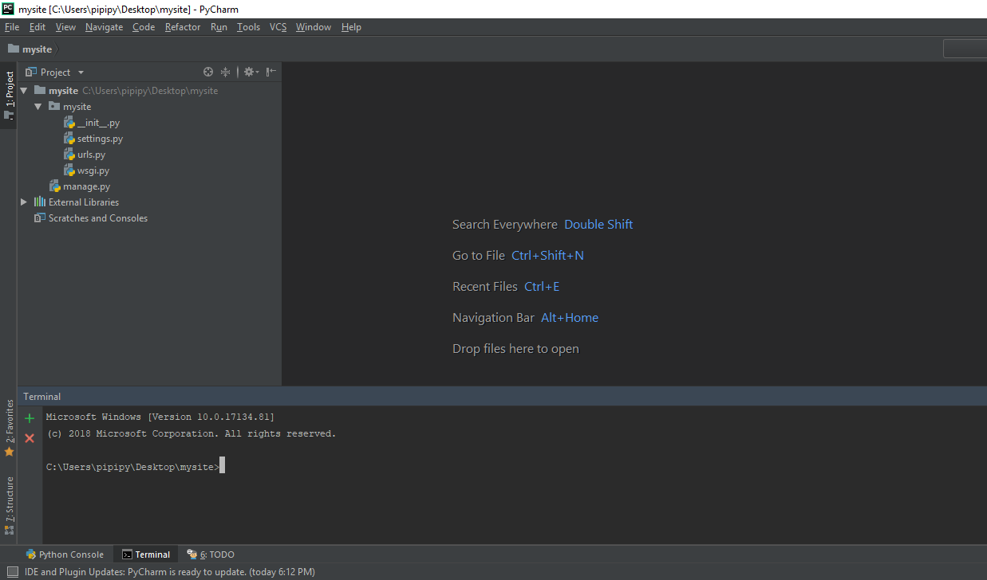
Open project In pycharm

Slide 10
Files
__init__.py:-it enanbles directory to be treated as packages.
Settings.py:-As name suggests it is used to adjust the various settings of the project which will be seen later on.
Urls.py:-manages urls configuration
Wsgi.py:-web server gateway interface. How a web-server communicates with the web applications

Slide 11
Create an app(app→ webpage)
Go to command prompt and enter the following command
django-admin startapp myapp

Slide 12
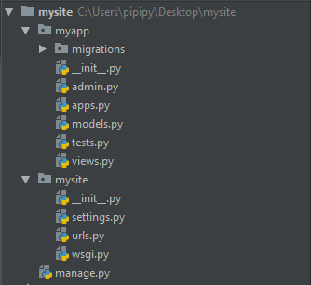
File structure

Slide 13
File structure contd…
__init.py__:- same
Admin.py:- allow options to edit admin interface and options(will see later on)
Apps.py:- configuration of app(we will not change)
Models.py:- contain defined structure of database
Tests.py:- test framework(out of scope of this training)
Views.py:- provides an abstraction layer b/w front end and back end

Slide 14
Install app
Go to settings.py
Find a list named installed_apps
Add your app name to the list

Slide 15
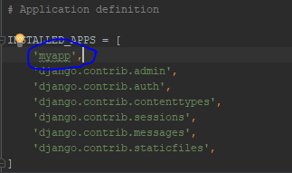
Install app contd..

Slide 16
Ready to go now
Initial settings are done!

Slide 17
Run your server
Go to command prompt and move to the current directory containing website and write the following command to run the server.
python manage.py runserver

Slide 18
Default ip and port
Default ip is- 127.0.0.1:8000
Changing ip and port:- python manage.py runserver ip:port no

Slide 19
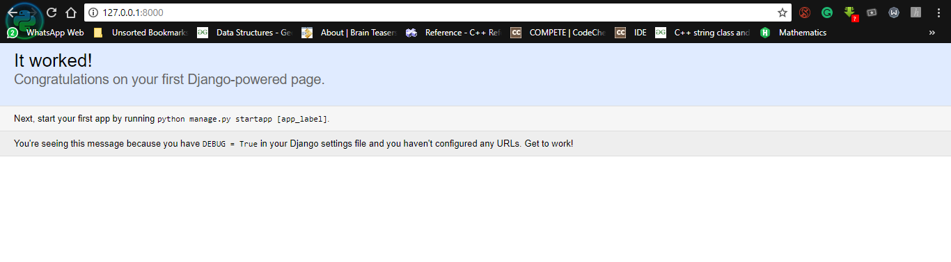
Lets visit localhost
Open browser and enter ip address
127.0.0.1:8000

Slide 20
Apply migrations
It is done inorder to import inbuilt tables like auth, admin used in login systems

Slide 21
Migrations contd..
Go to command prompt and enter the following command
Python manage.py migrate

Slide 22
Create admin
Go to command prompt and enter the following command
python manage.py createsuperuser
Now enter the details to create one.

Slide 23
We will treat homepage as an app
Verbally discussed why we need myapp.urls

Slide 24
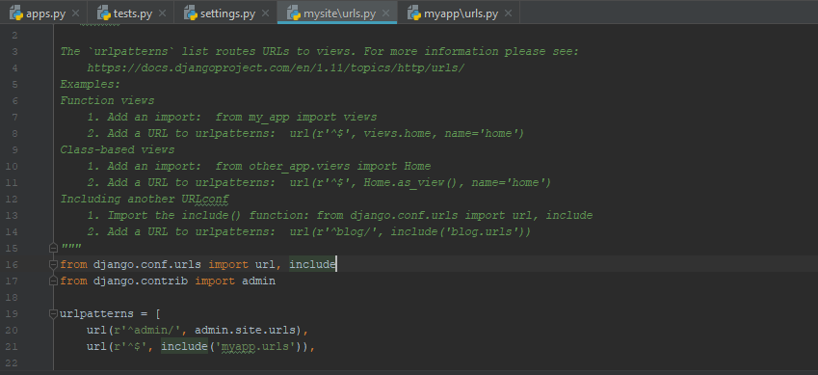
Mysite.urls

Slide 25
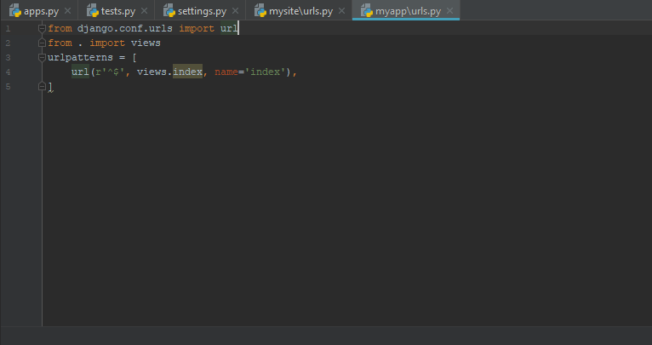
Myapp.urls

Slide 26
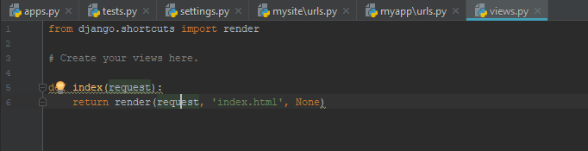
Creating views

Slide 27
Views explained..
Request is input to view which is generally a html data coming from the webpage.
Context is generally the output data which we want on the app output
Render function is used to give response back to html page

Slide 28
Views contd..
Where is index.html??
By default it is searched in the templates folder of that app.
Make a directory by the name of templates and make a html file named index.html and write a static front end code.

Slide 29
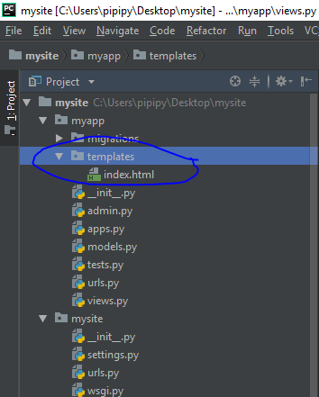
Template folder

Slide 30
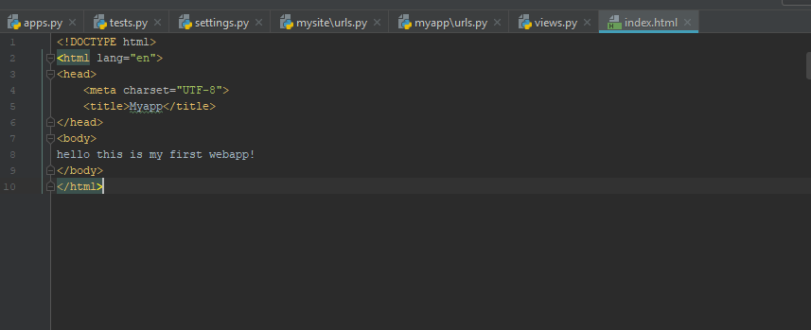
Index.html

Slide 31
Dealing with static files
Files like css, js, img files are dealt separately
There are called static files as they do not change
How to handle them

Slide 32
Static files contd..
Create a static folder just as we did in the case of templates
Inside static folder make separate css js img folder
Previous step not necessary but recommended in professional practices.

Slide 33
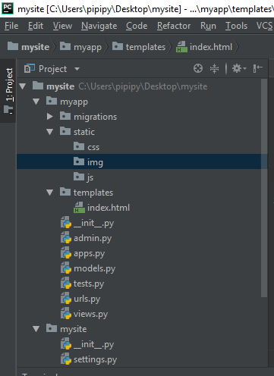
Static folder content

Slide 34
Working with css files
It is used to animate html with color and fonts and many other things
Make style.css and write the css code

Slide 35
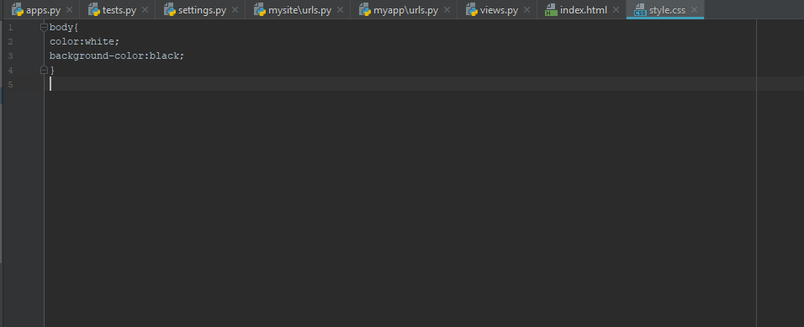
Css contd..

Slide 36
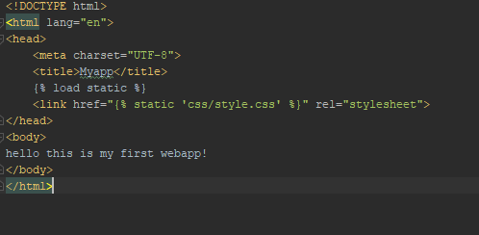
Linking css with html

Slide 37
Linking html with css
{% load static %} is used to inform html that static files are also there
{% static ‘static_file_path’ %} is the syntax for loading it.
Remember the above line has the general search directory as static folder which can be changed in settings folder.

Slide 38
Dealing with img files in html(Django version)
Same as css case
Insert a image in img folder

Slide 39
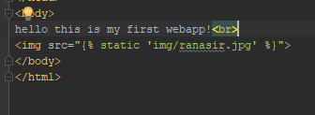
Img contd..

Slide 40
Js files..
Same as css and img files

Slide 41
This completes our basic part depicting how to connect html and django

Slide 42
Part -02 backend processing and displaying outputs to html

Slide 43
Starting with forms
Forms are a collection of text or files which bring data from front end to backend which can either be stored or processed and corresponding output can be generated and either be stored or passed to front end

Slide 44
Forms.py
Add this py file in myapp folder

Slide 45
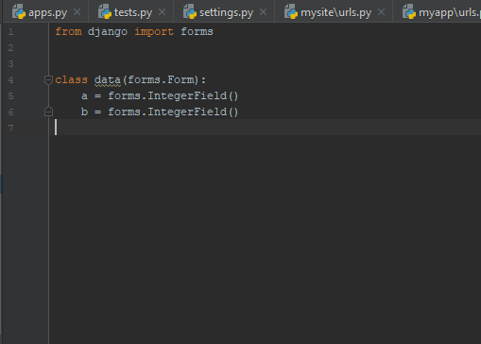
Forms.py

Slide 46
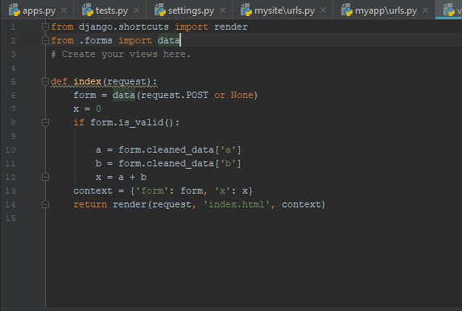
Views.py

Slide 47
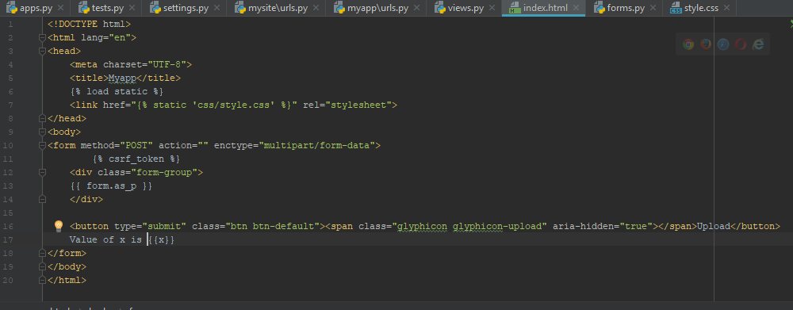
Index.html

Slide 48
Detailed procedure
First of all define fields in forms.py which you want to include in your form
Then move to views.py
Import the class which was made in forms.py and make its object

Slide 49
Detailed procedure contd..
Do the processing and pass the variables through context
Context is just a variable name of dict type
Dict is just a collection of key value pair
Key-> name by which it will be used in html form
Value-> name by which it was used in view in which it was processed.

Slide 50
Jinga templating
In Django we combine html with python which is provided by jinja
In jinja variables which have come through context are wrapped in {{ var_name}}
Python functions are wrapped in {% … %}
Eg:- {% if x>10 %} <p> hello </p> {% endif %}

Slide 51
Varations in this app [homework]
Value of x is (ans) appears only when result should be displayed
When result is calculated and displayed form should get hidden
Hint:- use Boolean checks
First student to mail the both the variations in a single app will be awarded.

Slide 52
Grasp Django [proj-1]
Create a textbox and convert the entered text into upper-case

Slide 53
Part-03 storing results in database

Slide 54
database
Stores data in form of rows and columns
Many popular databases eg: oracle ,sqlite
Default sqlite

Slide 55
How to create tables for database
Good news..
No need to know sql for databases
Django provides modals.py for entering tables through python code

Slide 56
Models.py
In the previous project now let us save each arithmetic calculation performed.

Slide 57
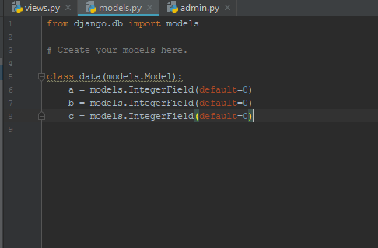
Models.py

Slide 58
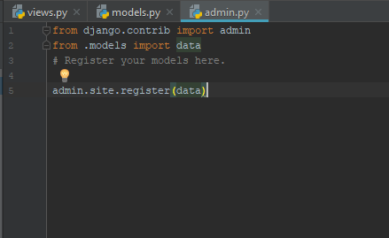
Register model (go to admin.py)

Slide 59
Apply migrations and then run server
Python manage.py makemigrations myapp
Python manage.py migrate

Slide 60
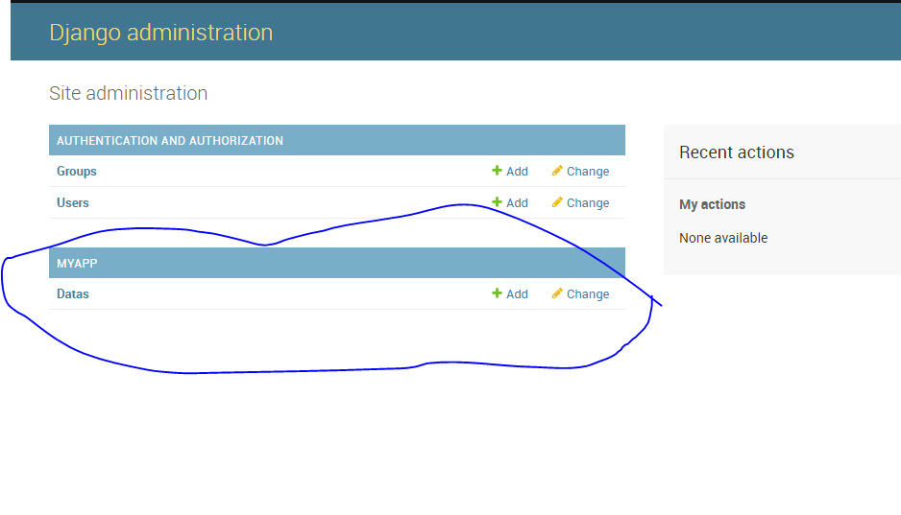
Open Django admin

Slide 61
Model-forms
We just noticed we just wrote redundant code in forms which we had already written in model
So we use model-forms
In this we create form just by specifying the model

Slide 62
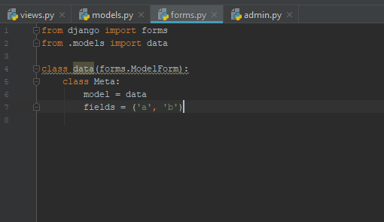
Forms.py

Slide 63
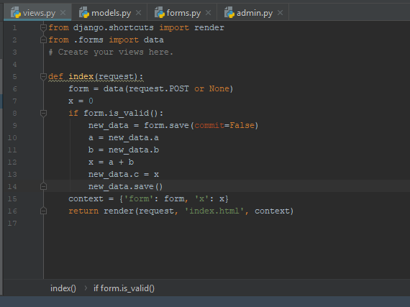
Views.py

Slide 64
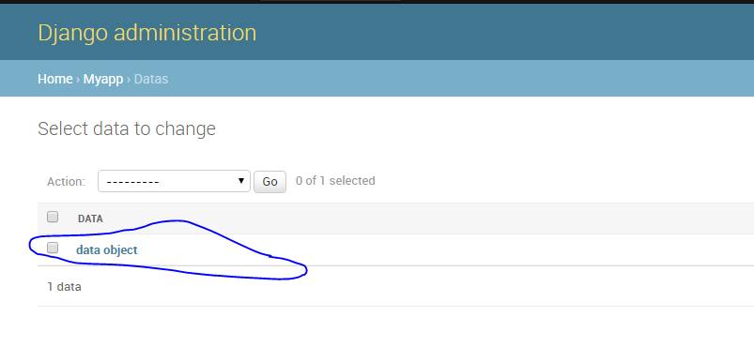
Now run app and see admin

Slide 65
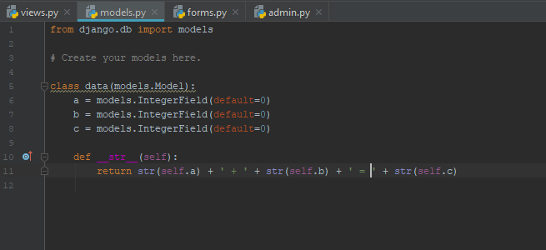
Change data object name

Slide 66
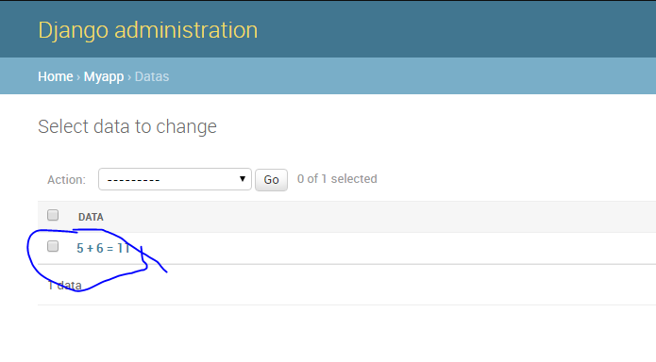
Now see admin

Slide 67
Upload files…
We will upload file and save it which can be later used on for processing..
We will create a separate folder to store files called as media folder

Slide 68
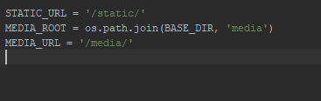
Settings.py

Slide 69
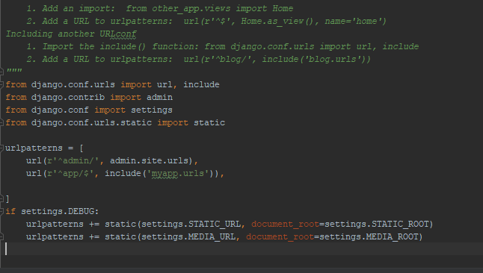
Mysite.urls

Slide 70
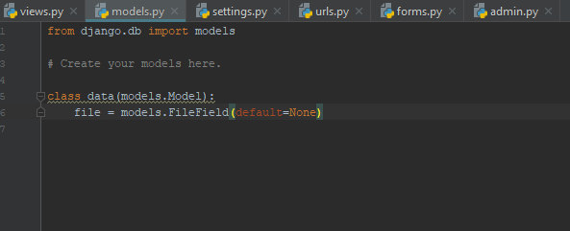
Add file field to models.py

Slide 71
Do change forms.py required field
Do not forget to apply migrations after each time models are edited

Slide 72
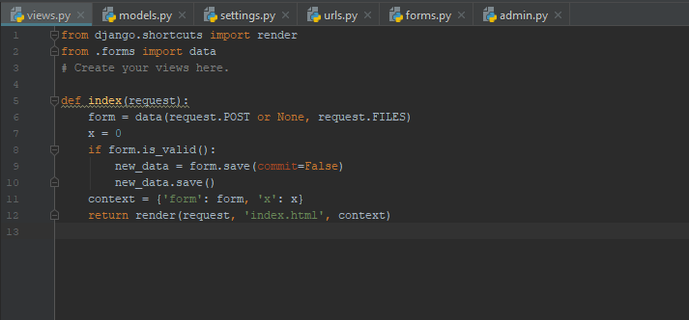
Views.py

Slide 73
Variations
I want each time a file is uploaded it should go in a separate folder under media and folder name should be a unique id

Slide 74
Home work (Proj-2)
Upload a file and convert the file contents into upper case…

Slide 75
Part -04 connecting r and python

Slide 76
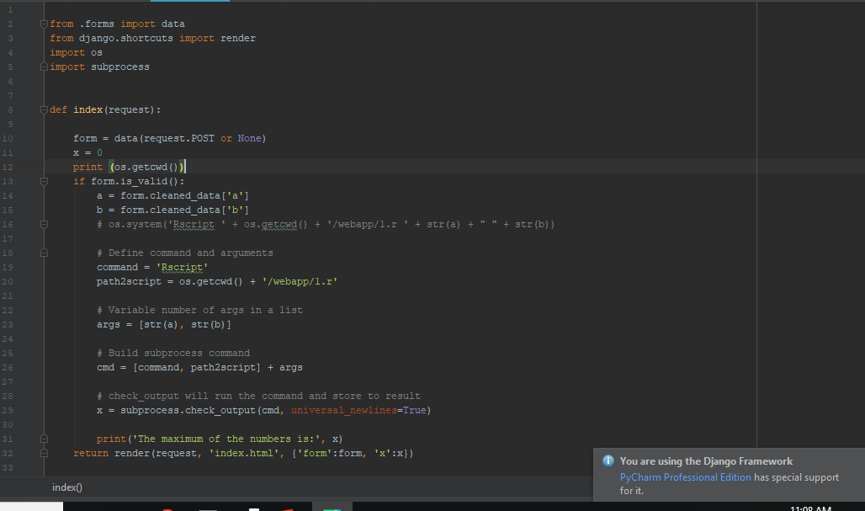
Checking views.py

Slide 77
Part-05 machine learning apps

Slide 78
We are going to study a webapp which predict the activity of drug molecule
(research paper submitted in imu journel)

Slide 79
Open the project
05-hse molecule

Slide 80
More apps
Text summarizier:- generates text summary through docx/text or even url link

